Slide 1
Design Patent Titles Do they matter? How much? Should they matter? How should you pick one?
Robert S. Katz
rkatz@bannerwitcoff.com

Slide 2
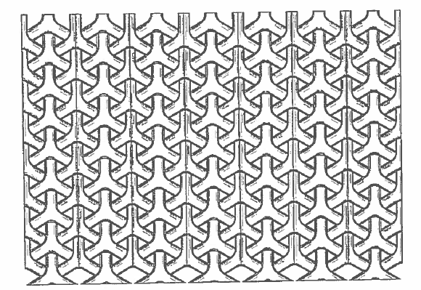
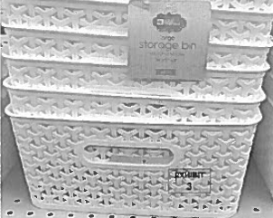
Curver-Luxembourg v Home Expressions
Title:
Originally: Furniture Part and Furniture (Part of)
As Issued: Chair
Title was amended (generally from furniture to chair)
A basket is not a chair
------------------------------------------------------------
In claim construction portion, the court considered the claim and applied prosecution history estoppel
A) whether there was a surrender of claim scope and
B) whether the accused design is within the scope of the surrender
Relying on prosecution history estoppel principles, the Federal Circuit found the design patent limited in scope based on the narrowing amendment to the title.
Accused Baskets

Slide 3
Tension – clear statutory language vs. case law
35 U.S. Code § 171 - Patents for designs
Whoever invents any new, original and ornamental design for an article of manufacture may obtain a patent therefor…..
35 U.S. Code § 289.Additional remedy for infringement of design patent
Whoever during the term of a patent for a design, without license of the owner, (1) applies the patented design, or any colorable imitation thereof, to any article of manufacture for the purpose of sale, or (2) sells or exposes for sale any article of manufacture to which such design or colorable imitation has been applied……
Gorham v. White, 81 U.S. 14 Wall. 511 (1871)
The Court concluded that since “…sameness of effect upon the eye is the main test of substantial identity of design, the only remaining question… is whether it is essential that the appearance should be the same to the eye of an expert.”
We hold, therefore, that if, in the eye of an ordinary observer, giving such attention as a purchaser usually gives, two designs are substantially the same, if the resemblance is such as to deceive such an observer, inducing him to purchase one supposing it to be the other, the first one patented is infringed by the other.

Slide 4
Examples

Slide 5
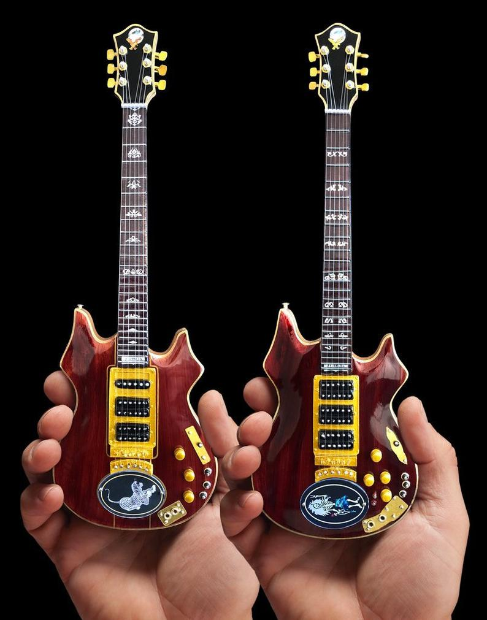
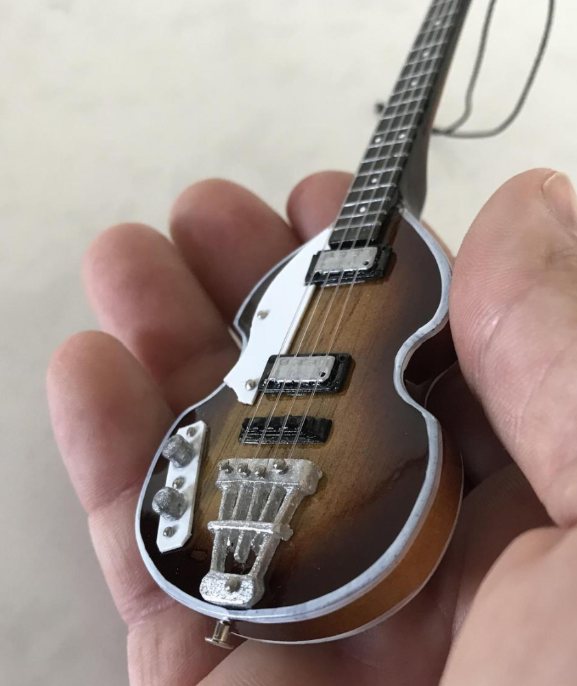
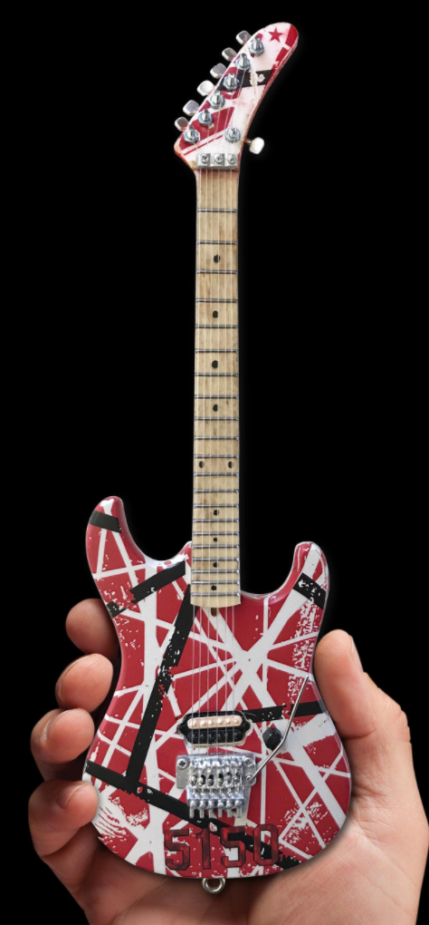
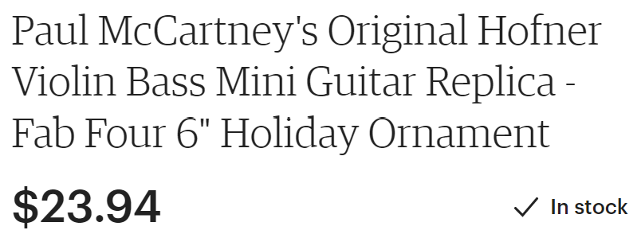
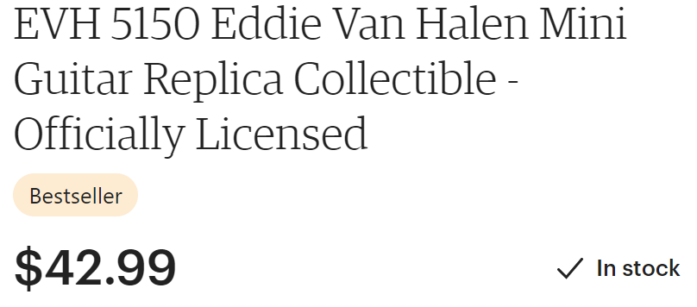
If the title is Guitar, do these Infringe?

Slide 6
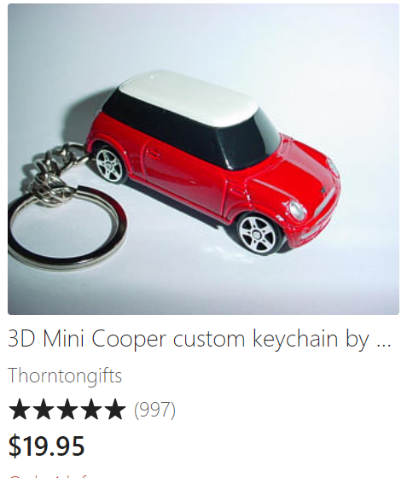
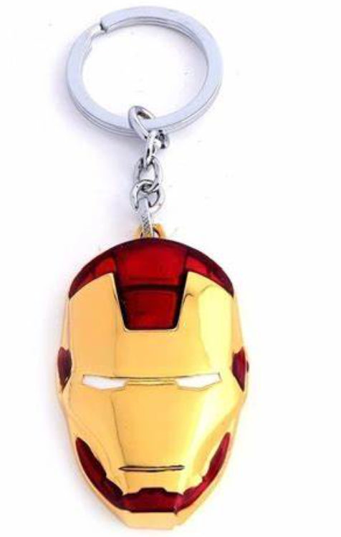
If the title is Car or Mask, do these Keychains Infringe?
Iron Man Red Gold Mask Keychain

Slide 7
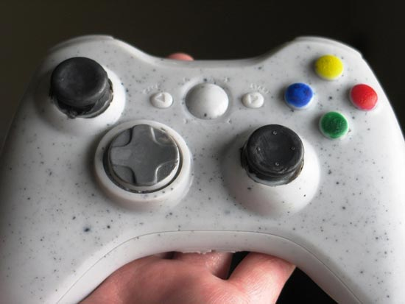
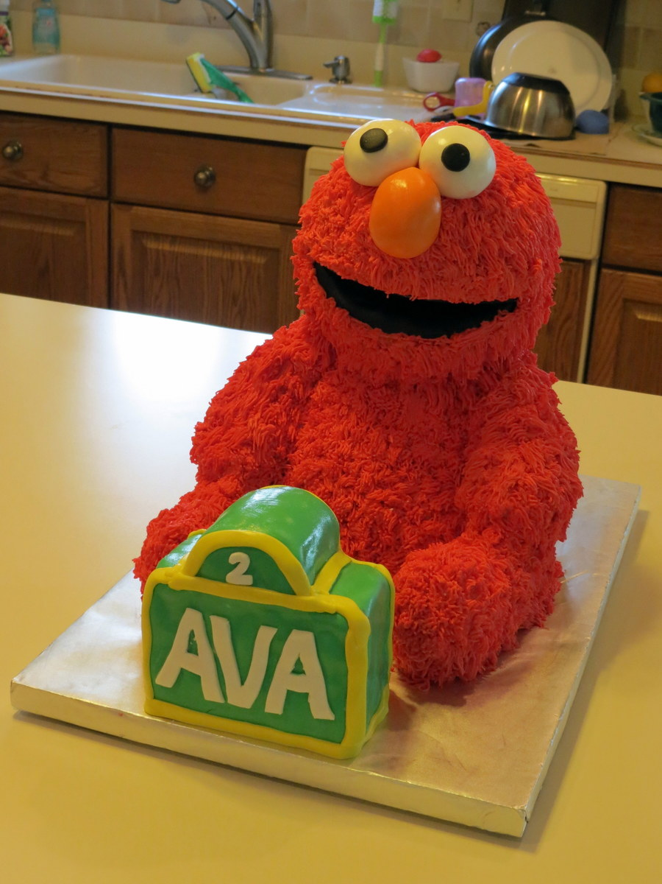
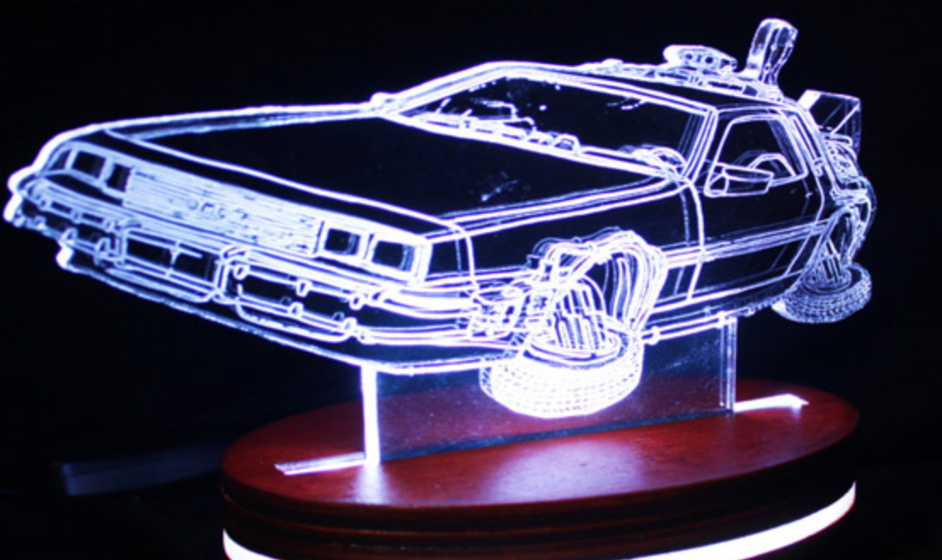
If the title is Controller, Puppet, or Car, do these infringe?

Slide 8
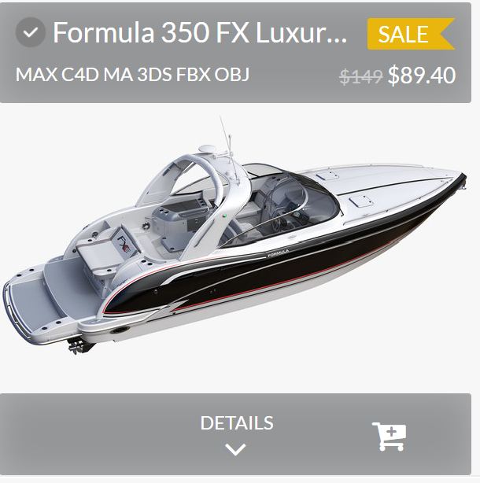
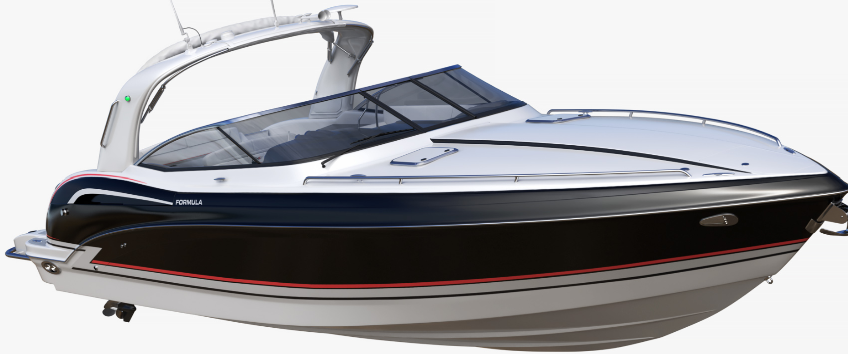
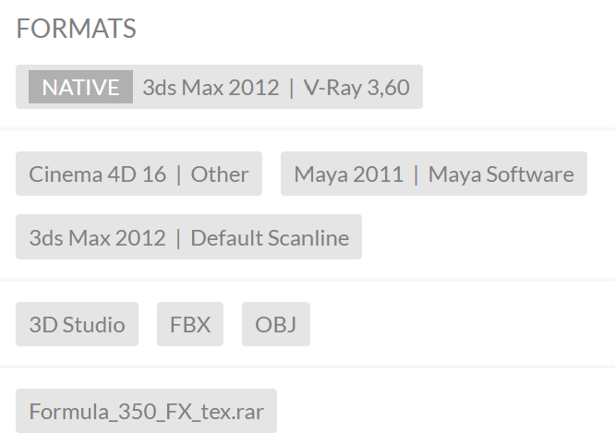
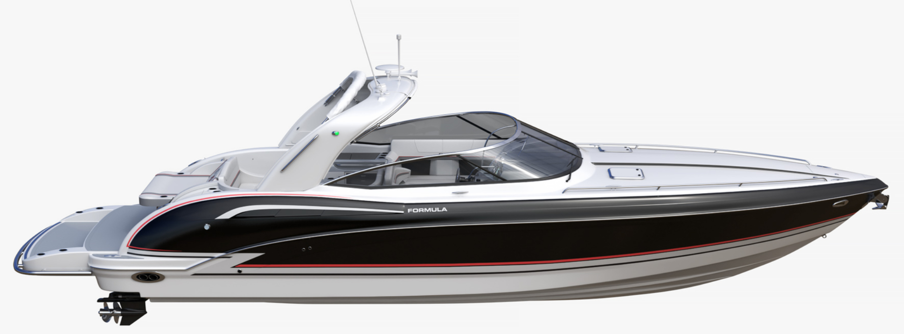
If the title is Boat, does this 3D Digital model infringe?

Slide 9
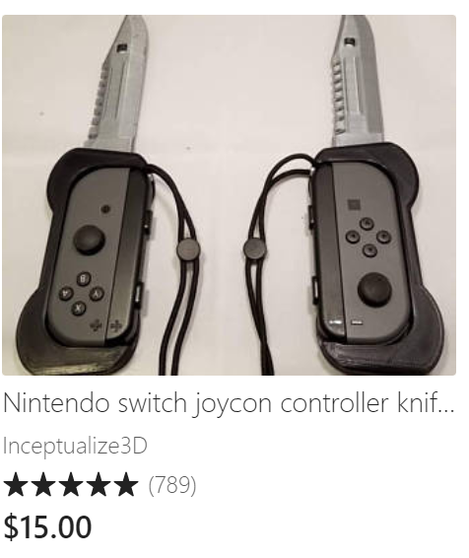
Imitation is not always a form of flattery

Slide 10
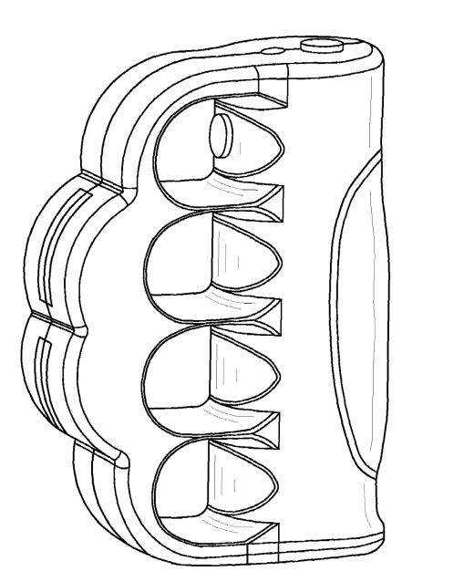
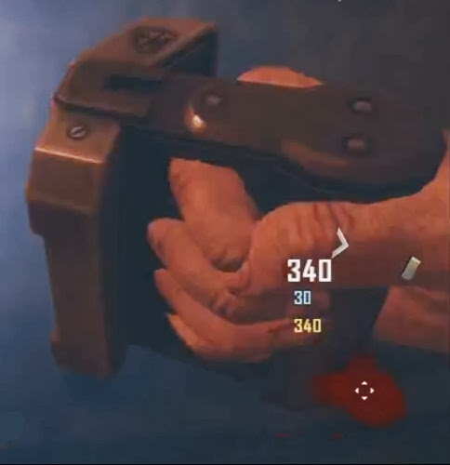
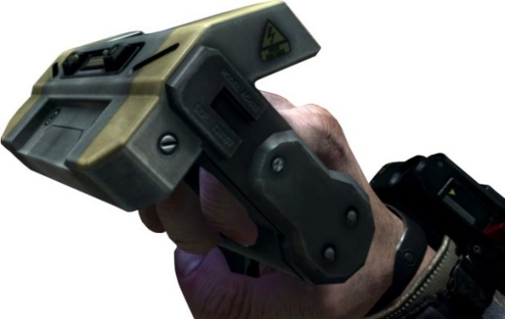
P.S. PRODUCTS v. ACTIVISION BLIZZARD -- US DC ARKANSAS
Design patent to weapon (brass knuckles + shock feature) Title “Stun Gun”
Video game maker made virtual weapon for game characters
Used in Call of Duty, Black Ops II
Looked nothing like the design patent
Activision Blizzard did not make or sell physical Galvaknuckles.
Dismissed for failure to state a claim (based on literal language from Gorham test)
"[n]o reasonable person would purchase defendants’ video game believing that they were purchasing plaintiffs’ stun gun”
P.S. Products' D561,294
Activision Blizzard's Galvaknuckles

Slide 11
Tension – clear statutory language vs. case law
35 U.S. Code § 171 - Patents for designs
Whoever invents any new, original and ornamental design for an article of manufacture may obtain a patent therefor…..
35 U.S. Code § 289.Additional remedy for infringement of design patent
Whoever during the term of a patent for a design, without license of the owner, (1) applies the patented design, or any colorable imitation thereof, to any article of manufacture for the purpose of sale, or (2) sells or exposes for sale any article of manufacture to which such design or colorable imitation has been applied……
Gorham v. White, 81 U.S. 14 Wall. 511 (1871)
The Court concluded that since “…sameness of effect upon the eye is the main test of substantial identity of design, the only remaining question… is whether it is essential that the appearance should be the same to the eye of an expert.”
We hold, therefore, that if, in the eye of an ordinary observer, giving such attention as a purchaser usually gives, two designs are substantially the same, if the resemblance is such as to deceive such an observer, inducing him to purchase one supposing it to be the other, the first one patented is infringed by the other.

