Slide 1
Hot Topics in Design Law and Practice: Effect of Trademarks on Design Patent Infringement Analysis
Tracy-Gene G. Durkin December 10. 2020

Slide 2
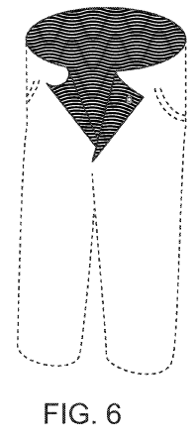
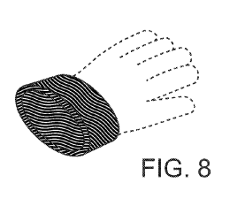
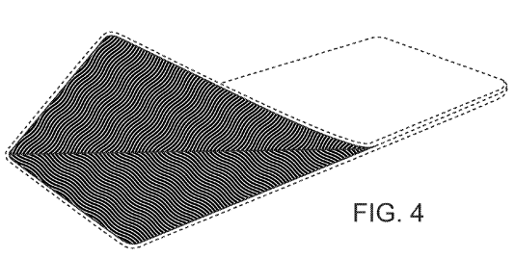
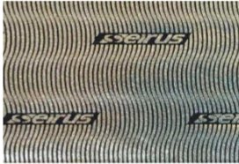
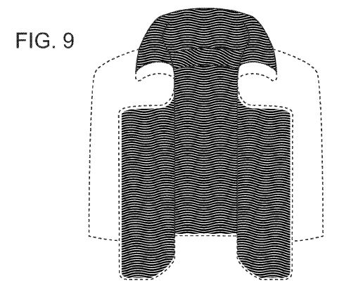
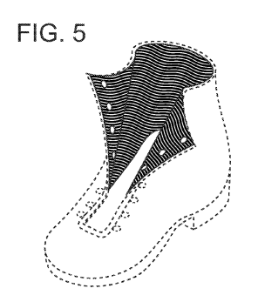
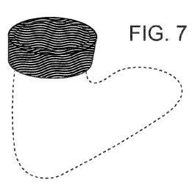
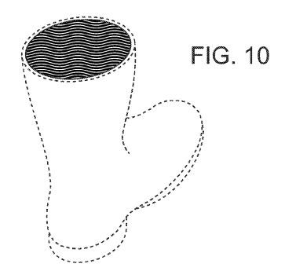
Effect of Trademarks on Infringement Analysis
Columbia Sportswear North America, Inc. v. Seirus Innovative Accessories, Inc., Fed. Cir. 2019
Accused Seirus Lining
Jury awarded $3M based on the total profit from the sale of the complete products sold by Seirus
D657,093 for Heat Reflective Material

Slide 3
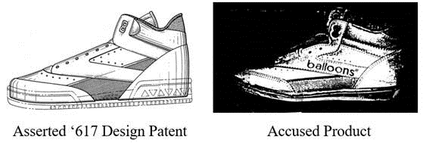
Effect of Trademarks on Infringement Analysis
“Design patent infringement relates solely to the patented design, and does not … allow for avoidance of infringement by labeling.”
L.A. Gear, Inc. v. Thom McAn Shoe Co., Fed Cir 1993

Slide 4
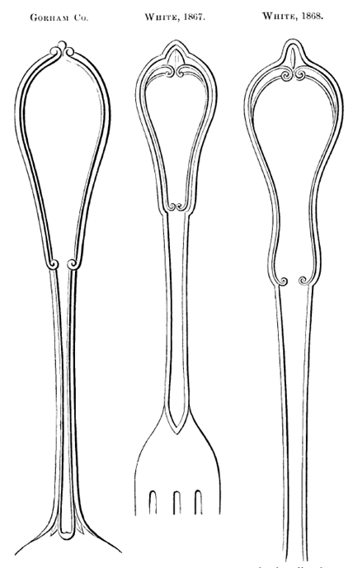
Design Patent Infringement
“[I]f, in the eye of an ordinary observer, giving such attention as a purchaser usually gives, two designs are substantially the same, if the resemblance is such as to deceive such an observer, inducing him to purchase one supposing it to be the other, the first one patented is infringed by the other.”

Slide 5
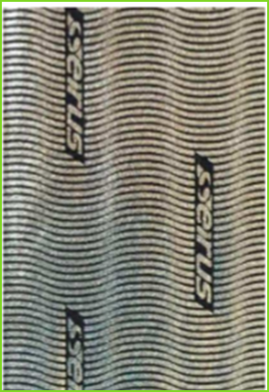
The Effect of Trademarks on Infringement
Fed Cir reversed jury finding of infringement on summary judgment because the “court improperly declined to consider the effect of Seirus’s logo on its infringement analysis”
Distinguished L.A. Gear where infringement was admitted
Under Gorham, must consider whether “the whole design is substantially the same”
Trial set for the end of this year

Slide 6
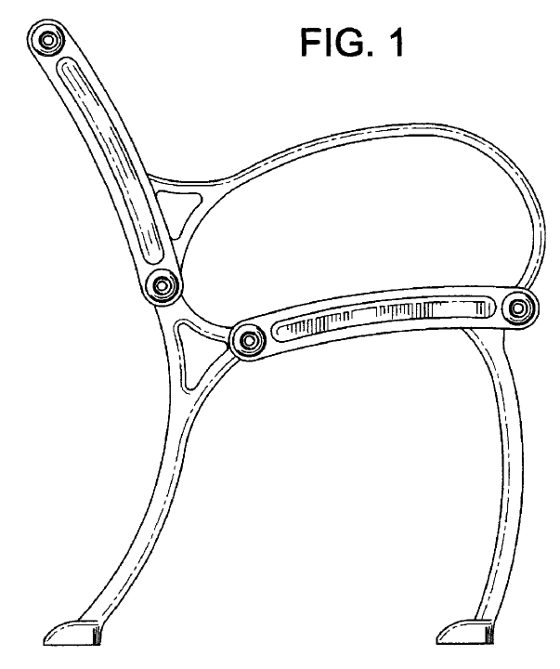
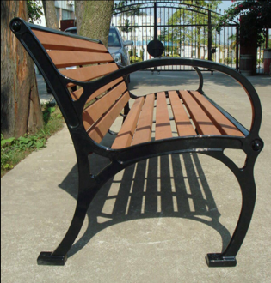
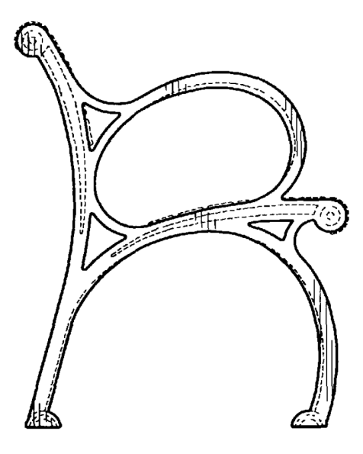
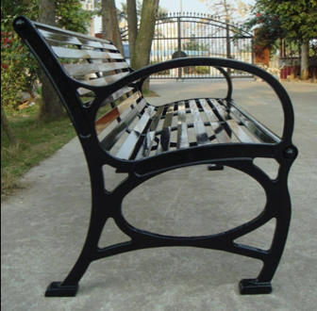
Victor Stanley, Inc. v. Creative Pipe, Inc.
(D.Md. 2011)
D523,263
Victor Stanley design
D419,341
Prior art design
Nebelli Bench
Creative Pipe design
Necati Bench
Creative Pipe design
“obviously distinguishing features on Necati bench … second brace and oval below the arm rest … ordinary purchaser would … distinguish ….”

Slide 7
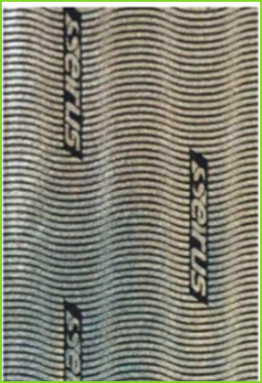
Can you Avoid Infringement by Adding Something to an Otherwise Infringing Design?

