Slide 1
LIGHTNING ROUND I: A Soup Can Dispenser’s Impact on Design Patent Obviousness
Alisa S. Abbott

Slide 2
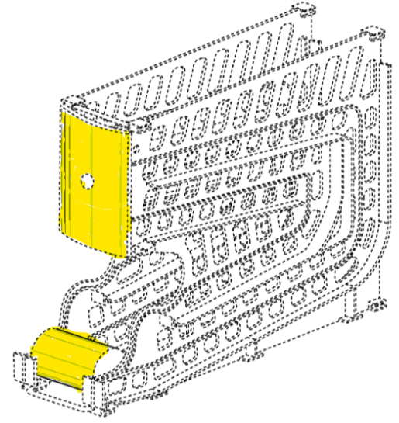
Campbell Soup Co. v. Gamon Plus (PTAB → Fed. Cir. → PTAB)
D621,645
(owned by Gamon Plus)
Appellants filed an IPR
Board instituted IPR: the design claim in‘645 patent was alleged to be obvious over Linz in view of Samways*
Design Law 2020

Slide 3
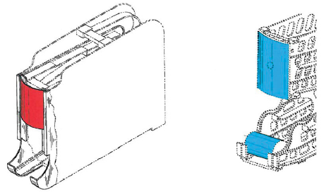
FIRST PTAB FINDING
D405,622
(Linz)
D621,645
(owned by Gamon Plus)
Board found that Linz was NOT a proper primary reference, essentially because it didn’t disclose any shape in the display area.
Board said that you can’t add a “hypothetical” can to Linz and THEN compare the designs – it’s improper under Durling because you have to consider the prior art in existence, and adding the can was not proper because it was not in existence in the reference.
Design Law 2020

Slide 4
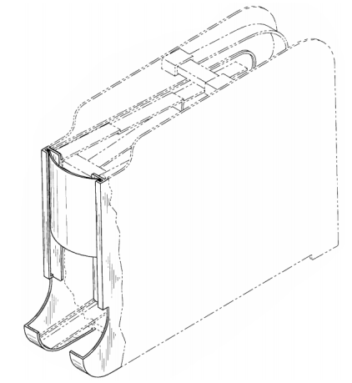
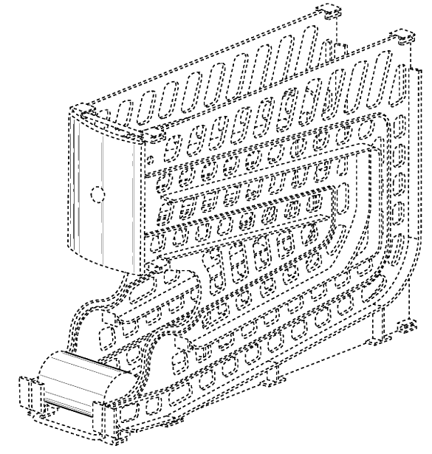
FED CIRCUIT RULING
Appellants argue that one of ordinary skill in the art would understand that the Linz dispenser was designed to hold cylindrical objects.
Assignee admission
Fed. Cir. held that the Board’s finding that Linz is not a proper primary reference is NOT supported by substantial evidence.
So, Fed. Cir. says that Linz IS a proper primary reference.
D621,645
(owned by Gamon Plus)
D405,622
(Linz)
Design Law 2020

Slide 5
Remanded back to the PTAB (July 29, 2020)
Now back at the PTAB, Board is required to treat Linz as a primary reference.
Issue on remand: Obviousness determination of what the can would look like, where it would be located – and would it have been obvious to have modified Linz to arrive at the patented design
Board recreated Linz to add the can, and they identified the differences (for example: in the ‘645 patent, the can was out further).
Design Law 2020

Slide 6
Remanded back to the PTAB (July 29, 2020)
Board relied on evidence of secondary considerations (commercial success and copying) presented by Petitioner to reach the conclusion that it was NOT shown to be obvious to modify the primary reference (Linz) to arrive at the patented design.
SO, while Linz is a proper primary reference under Rosen (as determined by the Fed. Cir.), it’s not obvious to MODIFY it (based on evidence of commercial success and copying) to arrive at the patented design.
Design Law 2020

Slide 7
What does this mean for obviousness?
Proposed primary reference missing an element
Secondary considerations including commercial success and copying by others
Design Law 2020

Slide 8
Alisa S. Abbott
(202) 824-3138
aabbott@bannerwitcoff.com

