Slide 1
Lightning Round II:
Update on Copyright Protection for 2D and 3D Designs
Ivy Clarice Estoesta
December 10, 2020

Slide 2
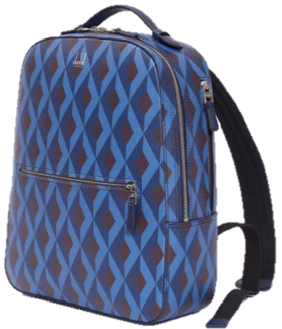


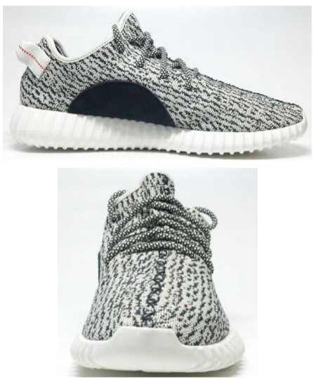
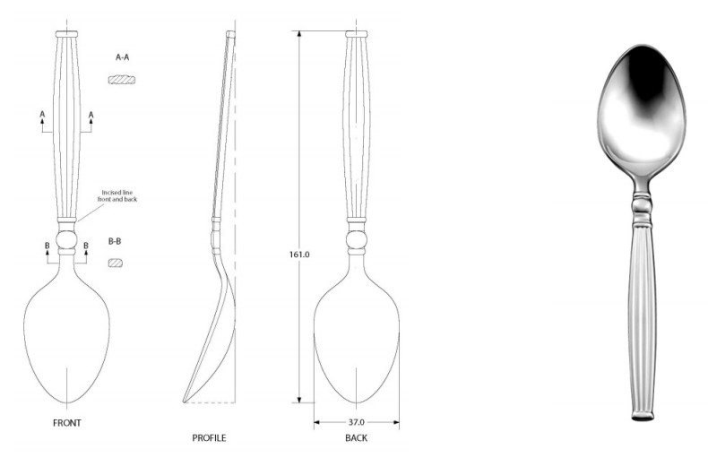
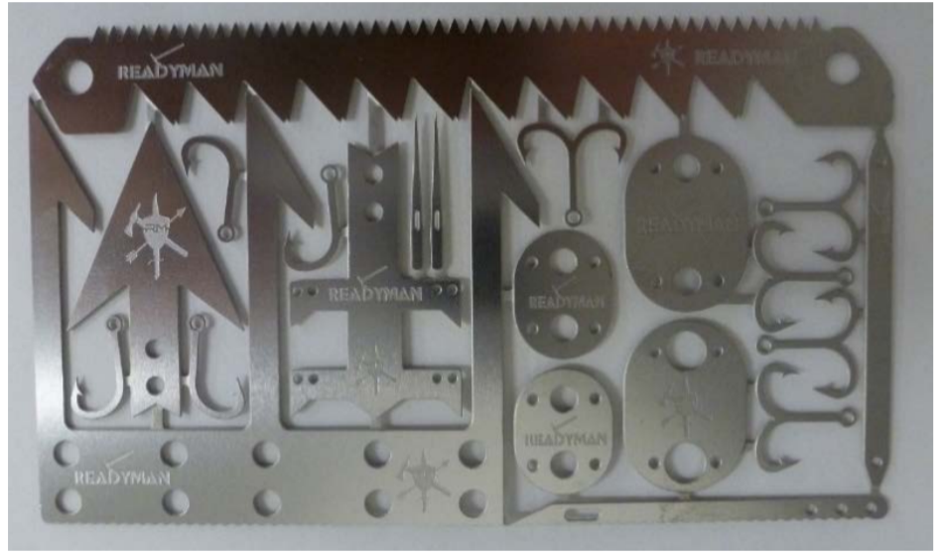
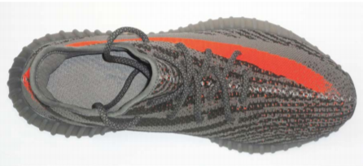
Which of these designs are copyrightable?
1.
2.
3.
4.
6.
7.
8.
5.

Slide 3
2-D/Non-Applied Designs

Slide 4

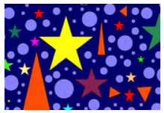
Copyrightability of 2-D Non-applied Designs in the U.S. – Originality
Independent creation
Sufficient creativity
  Low threshold: “minimal degree of creativity.” Feist Publ’ns v. Rural Tel. Serv. Co., 499 U.S. 340, 345 (1991).
Works not subject to copyright include “familiar symbols or designs; mere variations of typographic ornamentation, lettering or coloring; [and] … [t]ypeface as typeface.” 37 CFR 202.1(a)
  Copyright Office guidance: Works that merely consists of familiar symbols or designs may not be copyrightable unless the work, as a whole, is sufficiently creative

Slide 5


Alfred Dunhill Limited “Engine Turn” fabric pattern design (CORB Sep. 2019)
✗
Elements separately and as a whole are insufficiently creative
  “Diamonds and a six-sided arrowhead shaped polygon are uncopyrightable standard geometric shapes”
  “display of a few geometric shapes in a preordained or obvious arrangement”
  “elements create yet another geometric shape and the result of a single graphic design element repeated in symmetrical straight diagonal lines with standard coloring”
  3-D effect is not per se evidence of creativity
AA logo

Slide 6
Northwind logo (CORB Oct. 2020)
Combination of colors and shapes is sufficiently creative
  “The work includes two curved triangle shapes side-by-side, placed above a polygon shape … with an eight-point star placed in the middle of the right sail that curves to match the outside curved angle of the sail.”
✓

Slide 7
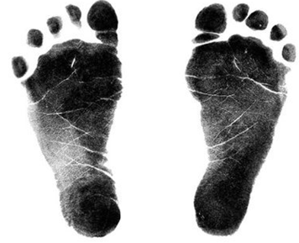




Heart in Feet (CORB Dec. 2019)
✗
Constituent elements of the work (feet and heart) are common and familiar
  Standard heart design
  Footprints are not determined by creative choices; dictated by human physiology
Arrangement demonstrates de minimus creativity; follows the natural physiology of foot arches forming curves that are similar to the curves in a standard heart design.

Slide 8
3-D/Applied Designs

Slide 9
Copyrightability of Applied Designs in the U.S. - Originality + Separability
Copyright does not protect useful articles
But, artistic features applied on/incorporated into a useful article may be eligible for copyright protection if they constitute (sufficiently original) pictorial, graphic, or sculptural works that (1) can be identified separately from, and (2) are capable of existing independently of, the utilitarian aspects of the article. Star Athletica, LLC v. Varsity Brands, Inc., 137 S. Ct. 1002, 1007 (2017)

Slide 10
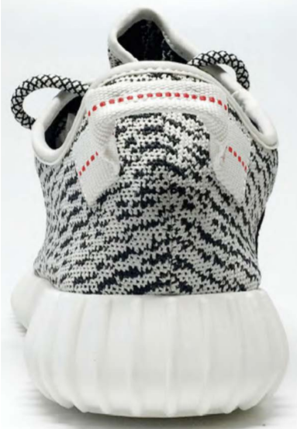
Yeezy Boost 350 Version 1 shoe (CORB May 2019)
✓
2-d artwork is copyrightable
  Irregular (black) lines of various lengths and shapes
  (black) Semi-circle in the arch
  (orange) dotted strip on heel loop
3-d sculptural work is copyrightable
  Not discussed in the decision; the “ruffling” (ridges) on the sidewall and midsole; not the overall shape of the shoe
Deposit

Slide 11
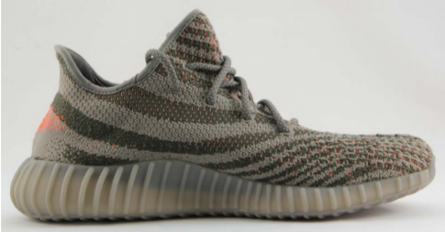
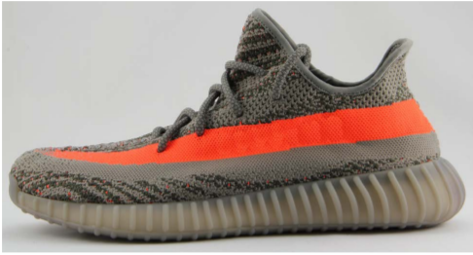
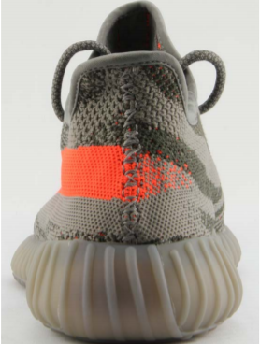
Yeezy Boost 350 Version 2 shoe (CORB May 2019)
✓
2-d artwork is copyrightable
  (gray) wave pattern
  thick (orange) stripe that fades
  Spots of intermittent (orange) created by inner (orange) layer visible through the outer (gray) layer
3-d sculptural work is copyrightable
  Not discussed in the decision; the “ruffling” (ridges) on the sidewall and midsole; not the overall shape of the shoe

Slide 12
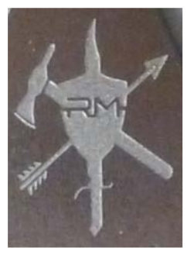
Wilderness Survival Card (CORB Dec. 2019)
✓
The logo alone is copyrightable
  a creative rendering of a shield and different tool shapes
The work as a whole is protectable
  Tools are not copyrightable, but their arrangement is creative; they are not mechanical or routine, or standard or symmetrical
✓
Logo
Survival Card

Slide 13
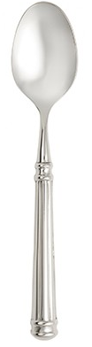
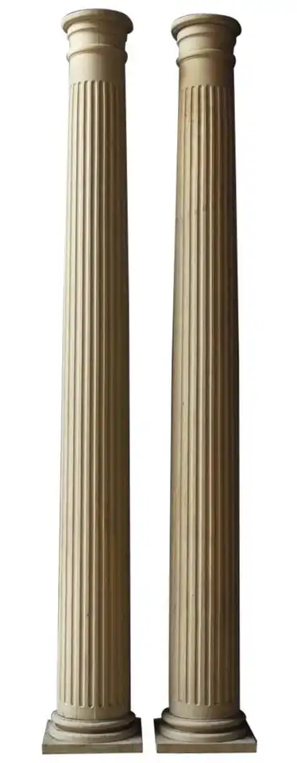
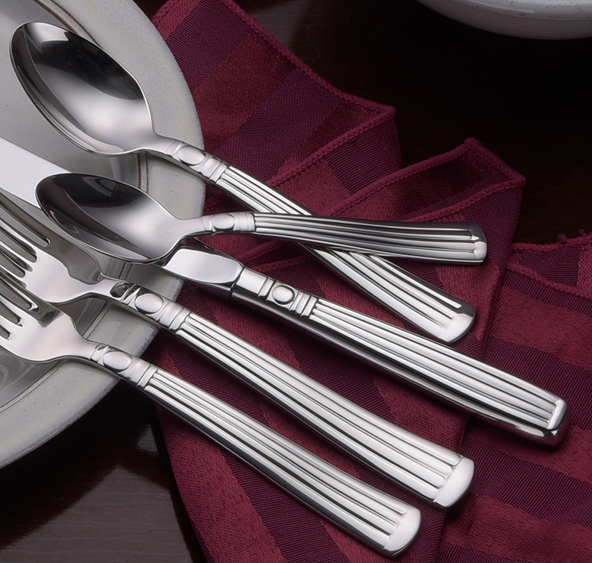
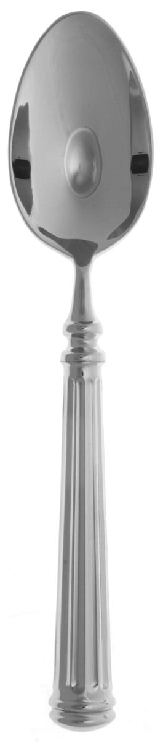
Colosseum Flatware Artwork (CORB Dec. 2019)
Elements of the design (evenly spaced stripes, a sphere, and basic lines) are standard geometric shapes
Compilation is typical and predictable; merely follows a standard neoclassical-style column/pillar; commonly found in contemporary flatware
WORK
CITED
✗
3/2/15?
1900
10/29/14
2/9/18
2007

Slide 14
Chalk holder in Lanard Toys Ltd v. Dolgencorp LLC (Fed. Cir. May 14, 2020)
(1) Separate identification of pictorial/graphical features: “Cartoonish no. 2 pencil sculptural work” cannot be identified separately from the utility of “storing and holding chalk and facilitating writing or drawing.”
(2) Independent existence: Cartoonish no. 2 pencil sculptural work is incapable of existing independently of its utility
  “[T]he pencil design does not merely encase or disguise the chalk holder, it is the chalk holder. When one imagines the pencil design as a separate work of sculptural art, one is merely picturing a replica of the chalk holder.”
✗

Slide 15
Copyrightable vs. Not Copyrightable

Slide 16

Ivy Clarice Estoesta
Counsel
Sterne, Kessler, Goldstein & Fox iestoest@sternekessler.com
(202) 772-8686

